Slide 1
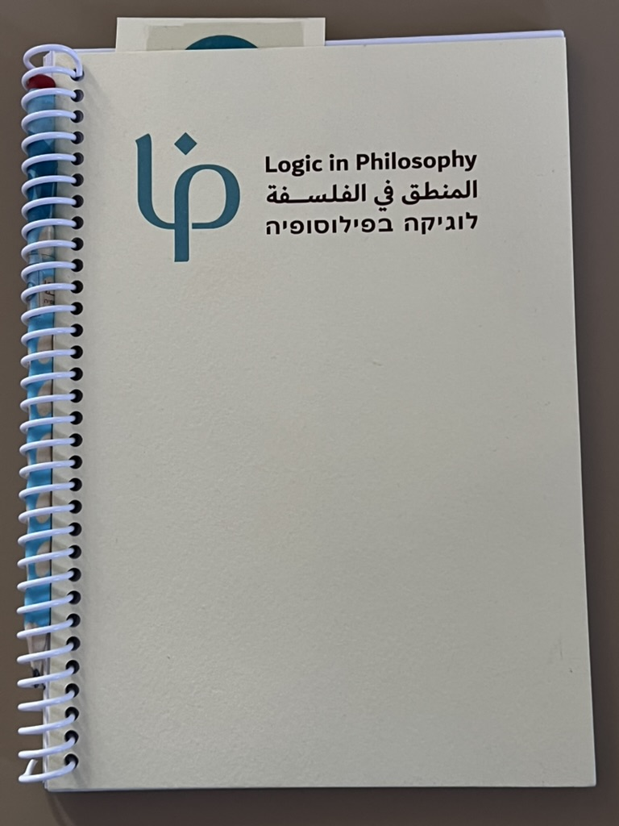
Academic Freedom 2026
LiP Academic Action in Arabic
Education on the Israeli Campus.
Dr. Ofra Rechter, Department of Philosophy.
Tel-Aviv University
2

Slide 2
How about the academic freedom of a philosophy professor to teach both her Hebrew speaking and her Arabic speaking students
On an Israeli Campus
Under any-and- all circumstances;
including in times of silencing crises,
devastating violence,
            a horrifying war?

Slide 3
Let’s start by asking about
the basic academic freedom
of a philosophy professor
on an Israeli Campus
to teach both her Hebrew-speaking
And her Arabic-speaking students
*
* Under any – and- all circumstances;
including in times of
  silencing crises,
  devastating violence,
  and a horrifying war.
3

Slide 4
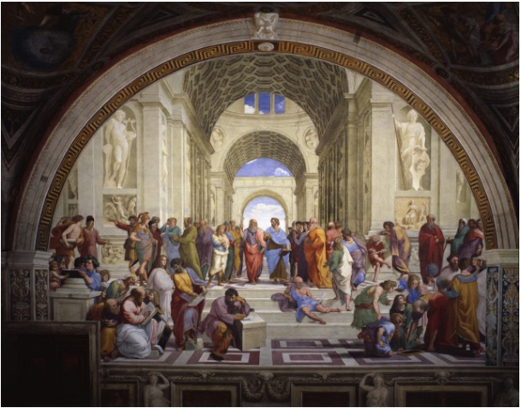
Logic in Philosophy (LiP)
LiP ACtAh: Academic Collaborative Translation into Arabic
Modern Mathematical Logic & Foundational Classics into Arabic
Notes on Metamathematics Goldfarb, W. ch. 1-4 Gödel’s Incompleteness Proofs into Arabic
Open-Logic Project into Arabic

Slide 5

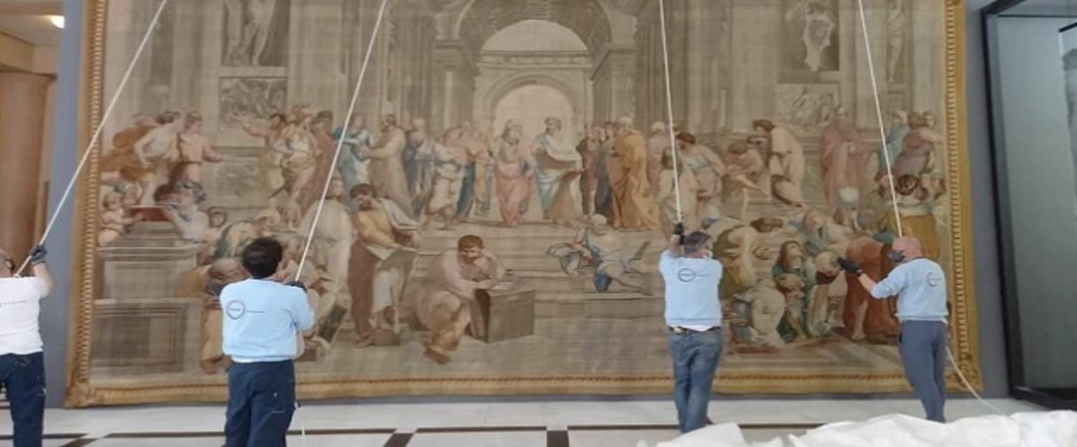
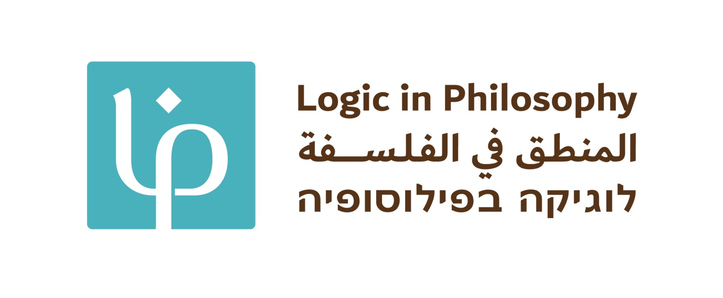
LiP

Slide 6
The Project
Translating metamathematics classics into Arabic - a novel collaborative attention to the study of modern mathematical logic by Hebrew and Arabic speakers.
The translation practices and its products open new paths for research and training.
The intended result is a living professional language.

Slide 7
Motivations
My students wanted to have a course-notes booklet in Hebrew and in Arabic. We were studying Gödel’s Incompleteness Proofs as presented in a 2018 version of Warren Goldfarb’s “Notes on Metamathematics”. An earlier version of which I used when as a Graduate student I was a TF for Goldfarb in Phil 144 at Harvard.
The presentation is exceptional in its natural relation to Gödel’s original work, and the philosophical and scholarly sensitivities driving its mathematical choices.
It was a big and intriguing surprise to discover that, unlike Hebrew, in Arabic, the professional metalogical language is limited.

Slide 8
Motivations
Motivations in relation to Academic Freedom:
To address the absence of sources in Arabic in contrast to the abundant materials in Hebrew, the dominating language on Israeli campuses.
Motivated and based on the power of the Arabic-speaking students, as a model of activism. The result contributes to the freedom for respectful attention to evolve as a social and intellectual second nature.
I believe that all these make a difference to the nature, scope and limits of our academic possibilities.
Working within our means to address concrete intellectual challenges and needs may stretch the limits of these very means.

Slide 9
Motivations
On campus, the provision of modern logical resources in Arabic can pave an Arabic-speaking student’s way to the study of philosophy bridging experienced language barriers
Off campus:
(i) exposure to philosophical and logical materials in various ways other than entering College.
(ii) engagement in the project implies exposure to the contributing fields including languages, history, linguistics, philosophy and mathematics, as well as the sciences.

Slide 10
A project?
Logic and mathematics have much of their origins and transmission in Arabic sources.
In the fundamental areas of modern mathematical logic, contemporary research is not normally practiced in a canonical Arabic language even in Arabic-speaking research communities.
The resulting linguistic gaps cannot be filled by stipulation.

Slide 11
A project?
In order to interrogate linguistic historical layers of intersecting vocabularies, we design a dynamic framework for a glossary and later a dictionary.
For these reasons we need experts in a rather special combination of areas, so that considered informed proposals we make can be assessed and can create an authoritative glossary base, worthy of serious linguistic assessment.
The construction of the team and the connection with the suitable linguistic authorities and counsel are an ongoing part of the project.

Slide 12
A project?
Methodological remarks:
we aim to highlight rather than suppress the interrelationships between the uses at diverse linguistic historical layers of intersecting vocabularies.
The issues are not to be resolved once and for all by the research, but rather than simply stipulate or leave entirely to future research or branching practices, we aim to use the insights and questions to motivate linguistic choice suggestions.
A scholarly version incorporates the materials and arguments as footnotes.

Slide 13
Comments!
Study materials can then be prepared and used in practice.
This practice in turn supports the revision and improvement of the dynamic LiP dictionaries and glossaries.
Importantly, we reach out to dispersed Arabic speaking students in the area, many of whom have lost their academic institutions,
Importantly, we gather and engage the scattered silenced needs of Arabic speaking students on Israeli Hebrew speaking campuses.
This is a linguistic- practice context in which the translation decisions can be reviewed, revised or flourish.

Slide 14
Comments!
We do not presume to contribute to these debates, but our project would be enriched by the research of these much respected matters.
A third point is that the subject of the development or lack thereof of Arabic language and practice in those fields in which the late 19th Century underwent profound revolutions is a sorely debated one among historians of the various related disciplines.

Slide 15
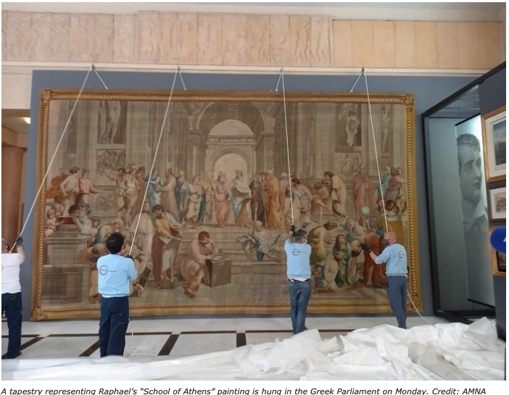


Slide 16
Call for the Logic in Philosophy hub
composed by and for the students circulated in Arabic
“University is a space where we learn and explore new ideas. But imagine if we could enrich our knowledge and minds through our own language [Arabic]—through our using it, conversing in it and discussing it? What if we could be learning and benefitting from our language as we contribute to it, and develop it? Surely, our university experience would be more enjoyable, profound, and meaningful.
The Logic in Philosophy Hub at the university invites you to join an initiative aimed at deepening our understanding of logic, emphasizing its philosophical dimensions. While an ancient and a contemporary sub-field of philosophy, logic is, quite simply, at the foundation of every field—from exact sciences to social sciences, and even the arts.
By participating in this initiative, you’ll have the opportunity to contribute to developing writings in logic and the philosophy of logic in Arabic—a language that urgently needs updating to keep pace with the significant developments in this field over the past century. Through this experience, you’ll learn about and discuss philosophical logic in an engaging and enjoyable environment.
If you’d like to know more details or are interested in joining, please visit the link below. You’ll find a detailed explanation of the initiative, along with the option to register with your name and contact info, so we can reach out to you.”

Slide 17
Why Arabic?
Arab-speaking students in Israel:
21% of the Israeli population are native Arabic speakers. Hebrew is typically their second language, and English is the third.
Between 2023-2024, native Arabic speakers constituted 20.6% of all higher education students in israel, and 22% of all undergraduate students.
12% of all students at Tel Aviv University are native Arabic speakers.
But the study of logic and philosophy relies almost entirely on study materials in Hebrew or original English or German.
The gap between Hebrew and Arabic in this field limits teaching and learning options; The project seeks to reduce this gap by creating a new professional linguistic basis in Arabic.

Slide 18
Why Arabic?
translations in the fundamental areas of modern so called mathematical or philosophical logic or the foundations of mathematics must face the Arabic tradition in concreto, through its texts, not in abstracto through speculative reflection on the history.
Translating logical texts into Arabic could pave a new path for engaging with the Arab-Islamic philosophical tradition through concrete conceptual work in logic, language and scholarship
The availability or lack in one’s mother tongue of culturally and academically core significant texts is not only a matter of facility of access for speakers to presumed shared treasures, opportunities, dreams or endeavors. For it affects the very sense of belonging, of freedom for pride of place. As to philosophy, on such facts stands or falls the possibility of developing an early and meaningful affinity for the field.

Slide 19
Background and context: Logic in Philosophy
Logic:
Logic is the gate to philosophy; it is a fundamental field in philosophy, connecting philosophy, mathematics, and computer science.
LiP TAU assumes that logical, mathematical, and academic literacy are prerequisites for quality philosophical education.
The status of logic in academia is facing new intellectual and pedagogical challenges: The program seeks to strengthen the place of logic in philosophy and carrying Abraham Fraenkel’s vision of making its foundational materials widely accessible further, in association with and beyond the limits of Hebrew.
Logic is not something that teaches you how to reason, but the study of logic and the ability to excel in it are keys.

Slide 20
Background and context: Logic in Philosophy
As part of this goal, the project promotes the translation into Arabic of classical and central texts in logic and the foundations of mathematics.
Translation serves as a tool for expanding academic accessibility, developing a professional language, and deepening diversity and participation in the world of philosophy.

Slide 21
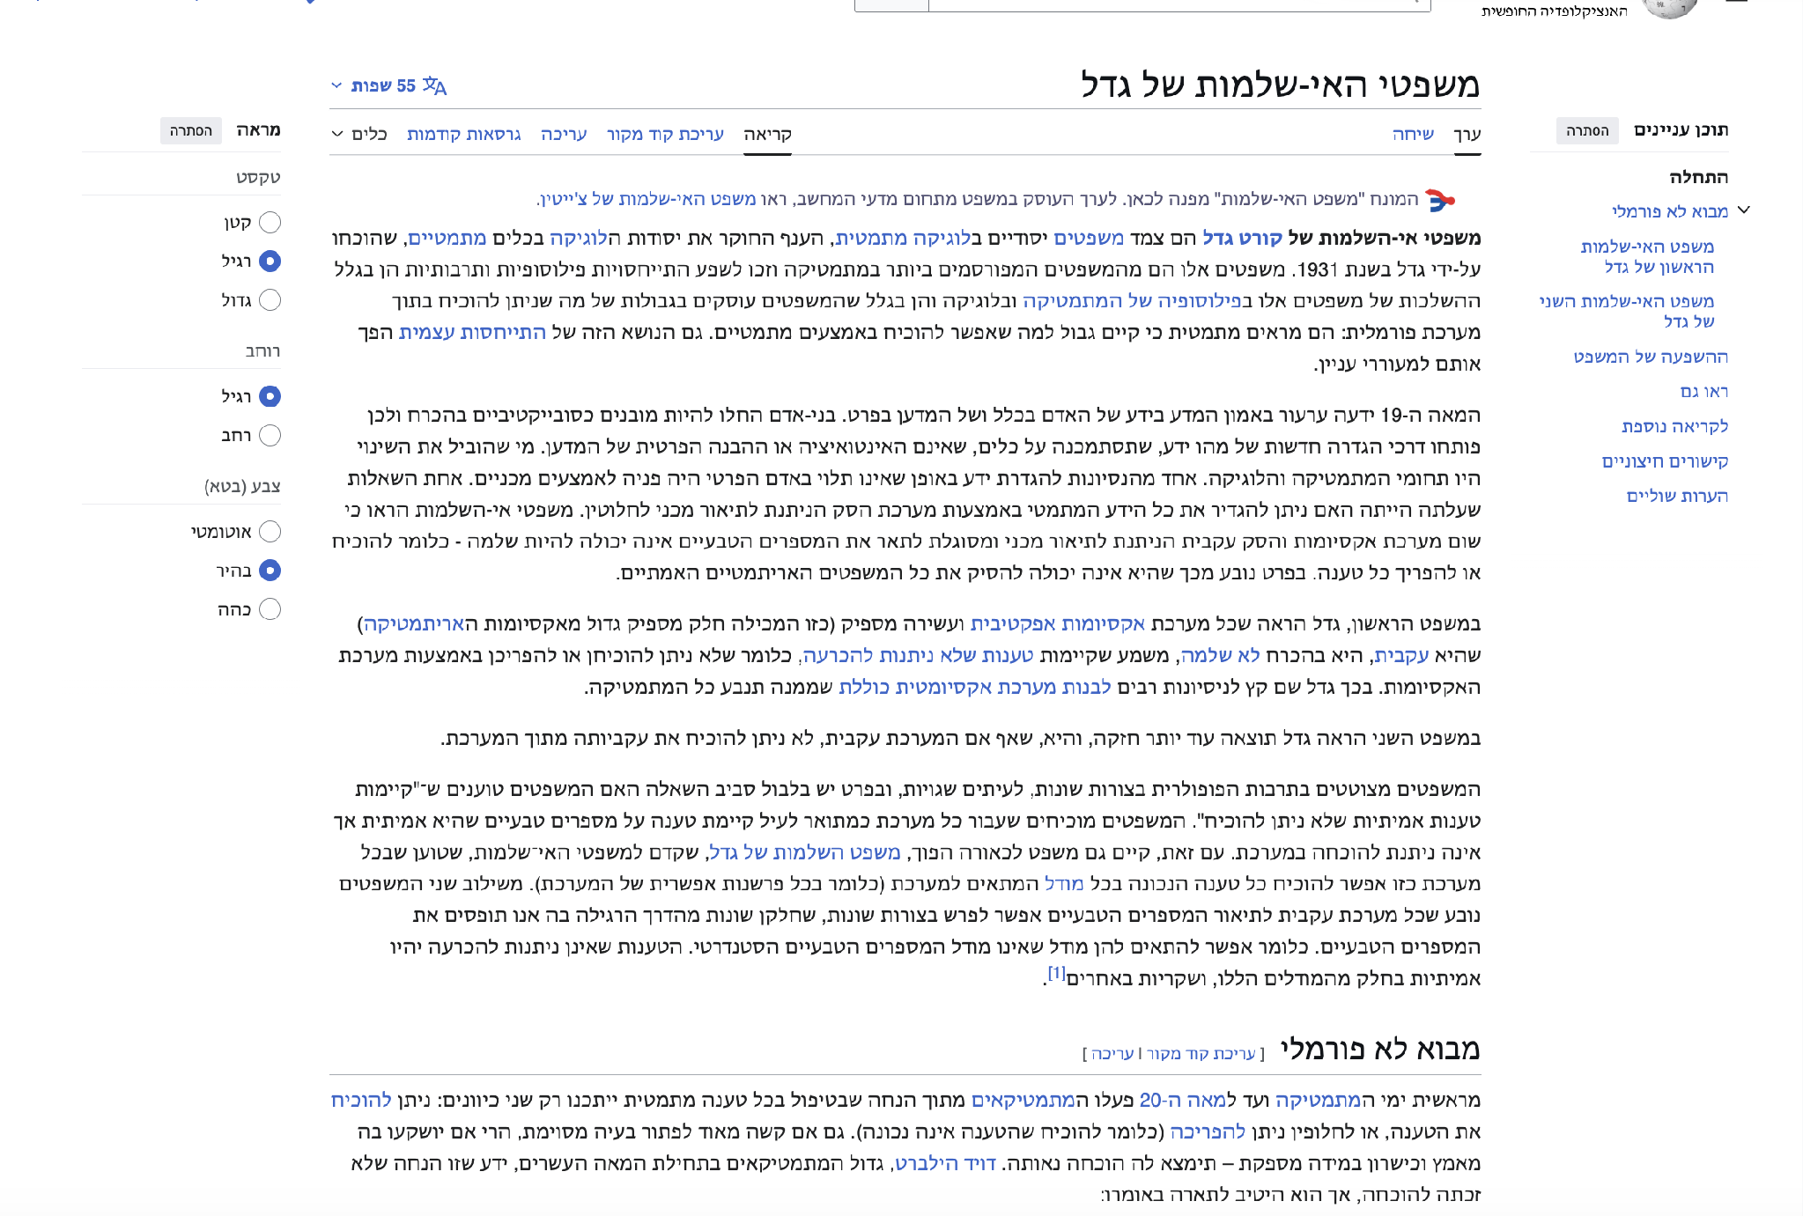
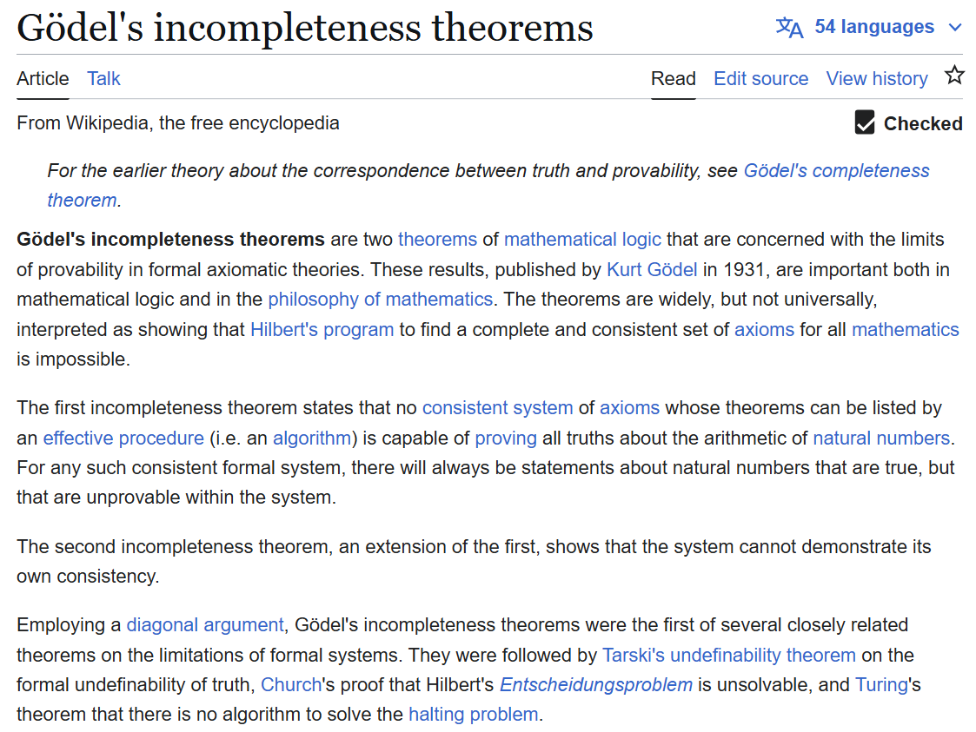
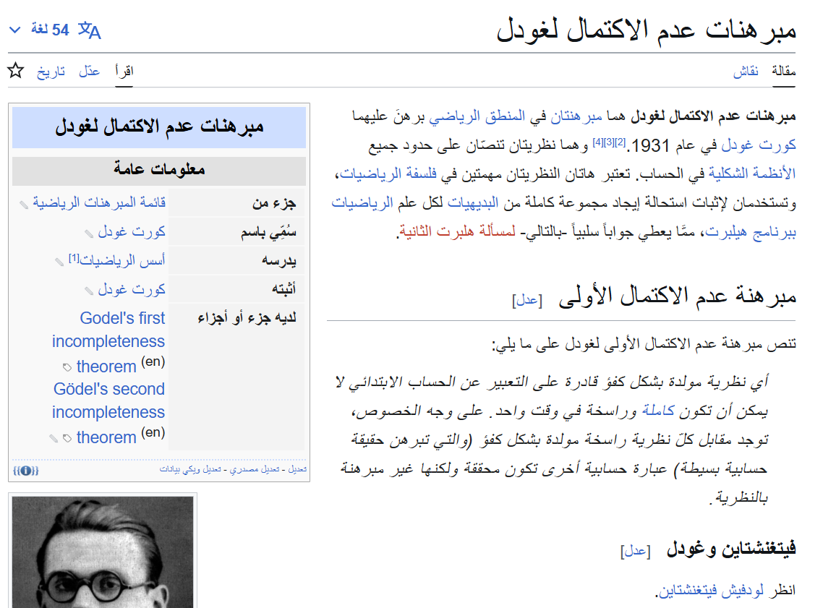
Example - Gödel’s Incompleteness Theorems on English and Arabic Wikipedia
The wikipedia pages in English and in Hebrew are very expansive, while the page in Arabic is very scarce

Slide 22
Project Goals
Primary Goals:
To address structural injustices in academic philosophy to remove barriers that impede participation in academic philosophy for members of marginalized groups.
To make basic materials in philosophy and logic accessible to Arabic-speaking students and support their academic success.
To develop a terminological and research infrastructure in Arabic, including a dynamic dictionary of philosophy that is more than a mere glossary, and is updated and developed over time.
To establish a living professional language in logic and philosophy that will serve scholars, teachers, students, and professionals and will continue to evolve through its use.

Slide 23
Project Goals
Evolving Goals:
based on recent developments in the use of and advancements in AI, it has become one additional goal of ours to keep up with its use in translation into Arabic. Therefore, perhaps it may be a worthwhile goal or mini-project to include as well. We are looking at a few examples of AI translations which seem to hold some promise.

Slide 24
Project Goals
Secondary Goals:
To promote the study and research of logic, metamathematics, and the foundations of mathematics through the work of translation.
To explore the connections between logic, philosophy, Arab intellectual traditions, theology, and history.
To promote a shared intellectual space through mixed working groups, bilingual learning materials, and digital tools.

Slide 25
The Project in Practice
Translates into Arabic the text Notes on Metamathematics by Warren Goldfarb, including the chapters on Gödel's incompleteness theorems.
A mixed translation team of students, researchers, and lecturers, working to develop professional terminology and build a dedicated Arabic glossary.
Develops Arabic learning materials, support programs for Arabic-speaking students, and teaching programs for outstanding high school students.
Uses the translation process as a laboratory for learning and research on language, translation, cognitive studies, human and machine proof-search and learning.
Creates a platform for cross-cultural collaboration and expanding participation in the study of philosophy and logic.

Slide 26
Why This Text?
The text is particularly suitable for teaching logic and metamathematics to philosophy students without a mathematical or technical background.
It combines current research with proximity to Kurt Gödel's original article (1931).
It allows for discussion not only of the results of the proof, but also of its presentation, its sources, and the significance of different alternatives.
It emphasizes the philosophical motivations underlying mathematical choices and moves.

Slide 27
Methodology
What would an alternative to stipulation be? In search of a scholarly and linguistic attention:
A translation team includes students, doctoral students, lecturers and researchers.
the scholarly excursus and its documented footnotes marks a potential research project to be revisited.
terminological dilemmas suggest historical sources, uses of the candidate terms in context; considered decision are documented in footnotes.
AI training with human control and evaluation, using existing translations, term banks and parallel texts can be assessed or harnessed for data.

Slide 28
Why AI and Machine Learning?
AI-based translation tools are quickly becoming the main tools of readers, students and researchers, and it is therefore important to develop and train them for philosophical and logical translation as well.
They enable comparison with related languages ​​and traditions, thus supporting the handling of complex translation problems.
The project develops a logical-philosophical translation assistant from English (and German, or French) to Arabic, based on Human-in-the-Loop and combining the capabilities of the model with guidance, validation and evaluation of human experts.
Large Language Models (LLMs) allow for translation scopes that are impractical for a human team alone.
Beyond using AI as a translation tool, the project examines how existing models can be improved using philosophical, terminological and historical knowledge generated during the work.
They help maintain terminological and stylistic consistency throughout a large-scale project.

Slide 29
Project Outputs
A bilingual course booklet (Hebrew-Arabic) including notes, formulas and formal sign languages.
Contribution to the Open Logic project and an initiative to develop a multilingual infrastructure for Logic content.
Development of a research dictionary and digital tools for working with Arabic, Hebrew and formal languages.
Development of digital teaching resources, including an accessible website and a dedicated learning center.
Academic publications in the fields of logic, translation and philosophical education.

Slide 30
Potential Future Impact
Educational and Community Impact:
Addressing marginalization on campus, in the education of philosophy.
A hub for philosophy enthusiasts for Arabic-speaking students in related fields (esp. CS, EE, Math) .
Students training and mentoring other students and educators.
Opportunities for our students to connect and engage in an international researching community and international projects.

Slide 31
Potential Future Impact
Research and Academic Impact:
Integrating insights and techniques from the fields of Logic, translation, and machine learning.
Enabling a regional collaboration that addresses the dialectic differences from a pragmatic perspective.
Developing a research understanding of “learning through translation” and the conditions for promoting successful learning methods.
Creating multilingual datasets that can support future machine learning and natural language processing research.

Slide 32
Achievements to date
An Arabic-Hebrew-English draft of the course booklet on Gödel's incompleteness theorems was completed, as part of the translation work of a classic in mathematical logic and metamathematics, which involves philosophical, conceptual, and philological research.
A full Arabic learning system was developed for the Philosophy Department’s Logic courses, including Moodle materials, online learning, and the LiP Translation Hub – the companion cell for Logic studies in philosophy.
The project expanded to a cross-campus framework, with participants from a variety of fields.
A joint activity was launched with the Ibdaa School (Sheikh Jarrah, Jerusalem), with the support of the Cohen Program.
An infrastructure was built for the continued development of the multilingual booklet, for academic publications, and for international collaborations, along with submitting applications for competitive research grants.

Slide 33
Participants and Contributors
Coming soon - our full site.
Interested specialists invited to come on board!
Write to us at:
logicinphilosophy@gmail.com
Rechter@tauex.tau.ac.il

