Slide 1


Academic Freedom Through the Eyes of Students
Lana Par
President of ESU

Slide 2

What is ESU?

Slide 3
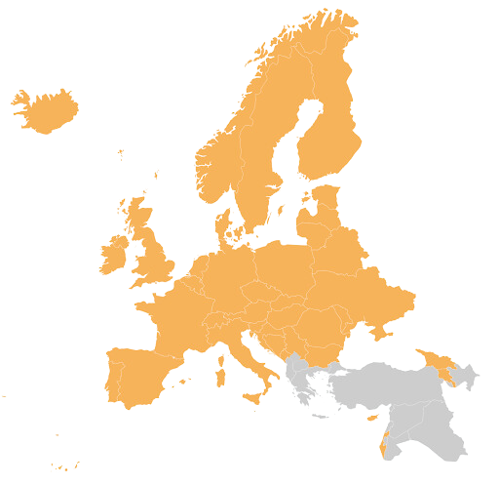





  43 National Unions of Students (NUS) from 40 countries
  20 million students across Europe
  Representing & promoting educational, social, economic and cultural interests
  Towards the European Union, the Bologna Follow-Up Group, the Council of Europe and UNESCO

Slide 4


The
Board
  2 votes per country
  Meets 2 times a year
  Discusses and makes decisions on policies and organisation, and elects the executive committee
Highest decision-making body of ESU

Slide 5








The
Executive Committee
The
Coordinator
Presidency Members
1 President
  Elected representatives for daily operations
  Responsible for steering and manage the organisation
  Carry out the decisions taken by the Board Meeting
  One year mandate
Human Rights and Organisational Development Coordinator
2 Vice presidents
7 General Members

Slide 6








The
Secretariat
The daily work of the Executive Committee
is supported by a professional Secretariat based in Brussels.
Head of Secretariat
Executive Assistant
Communication Manager
Trainees
Project Officers

Slide 7
What does ESU do?

Slide 8


2025/26 mark-up
following the Plan of Work
  Overarching Political Priorities
  Quality of Higher Education
  Social Dimension
  Internationalisation and Mobility
  European Education Area
  Public Responsibility, Governance and Financing of Higher Education
  Organisation, Development and Capacity Building

Slide 9
















Positions
Strategic Political Priorities
Plan of Work
Policy Papers
Statements & Resolutions
5-year strategic framework
Annual framework with short-term goals & priorities for the current mandate
Comprise views overarching different fields of higher education
Statements & Resolutions
Projects & Publications

Slide 10
Academic Freedom
Academic freedom is a universal value rooted in the pursuit of knowledge and truth.
Academic freedom designates the freedom of the academic community - including academic staff and students - in respect of research, teaching and learning and, more broadly, the dissemination of research and teaching outcomes both within and outside the higher education sector.
In essence the concept ensures that the academic community may engage in research, teaching, learning and communication in society without fear of reprisal
Academic freedom must be framed by rigorous scientific and professional standards, respect for the rights of others, ethical conduct and the awareness of the impact of research on humans and their environment
Academic freedom can be understood to comprise the freedom to learn, to teach and to research, with each of these freedoms entailing the freedom to think, to question, and to share ideas, both inside and outside the higher education sector

Slide 11
Academic Freedom
The freedom to teach
  can only be realised concretely in combination with public and social responsibility and institutional autonomy.
  Public authorities have the responsibility to ensure that relevant higher education programmes are offered to citizens, while autonomous higher education institutions assume a large responsibility for research underpinning programmes, and for how programmes are taught.
  Academic staff also exercise a strong responsibility in setting the curriculum and programme components, and developing the teaching methods employed.

Slide 12
Academic Freedom
The freedom to research
  The freedom to research includes the right, consistent with professional standards of the respective discipline, to determine:
    what shall (or shall not) be researched;
    how it shall be researched;
    who shall research,
    with whom
    what purpose research shall be pursued;
    the methods by which, and avenues through which, research findings shall be disseminated.

Slide 13
Academic Freedom
The freedom to learn
  the freedom to teach also raises the question of who is to be taught and is thus intimately linked to the freedom to learn.
  These values relate to equitable access, with a range of issues on criteria and conditions for access to higher education needing to be addressed through societal dialogue and administrative procedures
The freedom to learn is rarely recognized in constitutions or higher education laws, whereas the freedom of science and teaching is more commonly protected. This creates a legal hierarchy that disadvantages students. To address this imbalance, the freedom to learn and students’ rights to participate in higher education governance must be equally enshrined in constitutional and other relevant legal frameworks.

Slide 14
Academic Freedom
For students, academic freedom:
Guarantees freedom to learn, question, and develop independent thinking
Creates safe learning environments, free from fear, censorship, or retaliation
Ensures access to diverse ideas and perspectives, essential for critical learning
Protects the quality of teaching, grounded in academic standards rather than external pressure
Empowers student participation, allowing students to express views on institutional policies
Strengthens democratic citizenship, by fostering open debate and responsibility

Slide 15
BWSE 2024
15 out of 36 NUSs answered that they are not involved in any discussion on academic freedom with public authorities, pointing towards a lack regarding the continuous promotion and protection of academic freedom in the EHEA
A worrying 14 out of 36 NUSs report that there have been incidents where students have been subject to threats or consequences due to their student activism in recent years. As responsible for these incidents NUSs reported equally often that public authorities, higher education institutions’s leadership and academic and administrative staff were the aggressors

Slide 16
Lately, the European Students’ Union has seen the erosion of academic freedom as one of the top priorities for National Unions of Students (together with the overall erosion of democracy)
ESU has also analyzed the latest findings of the EP Academic Freedom Monitor and the data in the annual Academic Freedom Index (March, 2026)
What are we worried about?

Slide 17
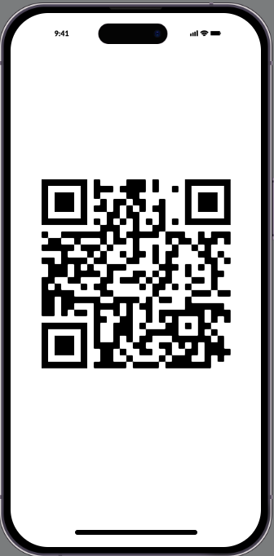
What did we find out?
Academic freedom is not collapsing overnight, but is steadily eroding
EU members states that declined in the Academic Freedom Index:
  15 out of 27, over the past year
  24 out of 27, over the past 5 years
  25 out of 27, over the past decade

Slide 18
The commercialization and commodification of higher education
Political pressure, the growth of polarisation and the overall erosion of democracies
Anti-intellectualism and societal pressure
Security policies and foreign interference
Fundamental values of higher education placed at risk
Main challenges, from the perspective of students

Slide 19
Some of the measures students see urgent for decision-makers to implement
Establishing legally binding protections for students, staff, scholars and higher education institutions
Protecting higher education from political interference and polarization
Addressing risks stemming from commercialisation, commodification and private sector influence
Recognizing and protecting students at risk, by, inter alia, expanding current frameworks to address the growing vulnerabilities of students across Europe;
Recognizing students as full rights-holders of academic freedom and as key stakeholders in its protection

Slide 20
Student Protests Monitoring
September – November 2025
From September to mid November 2025, we tracked 25 distinct student protests across the European Higher Education Area, with some starting even in January 2024.
They stretch across 13 countries: Armenia, Belgium, France, Germany, Greece, Ireland, Italy, the Netherlands, Romania, Serbia, Spain, Switzerland and Türkiye.
November 2025 – January 2026
7 of 13 protests started during the reporting window, indicating an ongoing “new wave” rather than only continuation of older cycles
1 case began already in 2024 and continued into this period
3 cases began in early 2026 and fall within the window

Slide 21
What drove students to act
Democracy and governance
  6 cases explicitly reference Political Governance/Democracy
  Most often paired with Government Transparency, as seen in 6 cases
  4 add Corruption & Nepotism as a cause
  Resignation of Government Officials appears in 3 actions
  End of Authoritarian Practices is also noted in 2 actions
Higher Education Institutions
  2 cases request Higher Education Funding Increase
  A call for more Transparency in Universities also appears throughout Material conditions and access
  3 protests involve Economic & Living Conditions
  5 mention Access & Safety in Education
  3 reference Security & Policing
  6 protests include Human Rights & International Solidarity
  3 cases involved Divestment from Conflict States

Slide 22









Follow us !
@Europeanstudents
@esu.online
@EuropeanStudentsUnion
www.esu-online.org
@esuonline.bsky.social
@ESUtwt

