Slide 1


Bridging the gap: criminologies of atrocity, criminologies of serious economic crimes
Andy Aydın-Aitchison Edinburgh Law School @Andy8chi

Slide 2
Opening remarks
Criminology, criminal lawyers and a plan

Slide 3
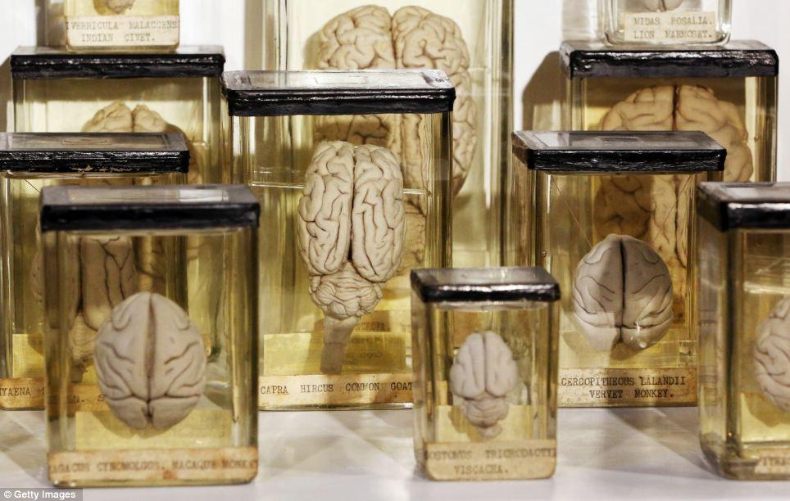
A meeting of minds
Me, a criminologist of atrocity
You, criminal lawyers, prosecutors of serious economic and environmental crimes

Slide 4
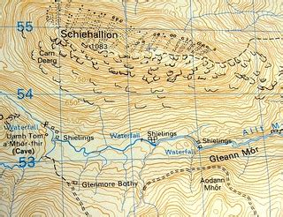
Orientation
A case for combining criminologies
Points of convergence
Atrocity criminologies
Integrated exemplars
End point
  Accountability
  Prosecutorial strategy

Slide 5
Why study atrocity and serious economic crime together?
Commonalities, interdependence and ‘criminal careers’

Slide 6
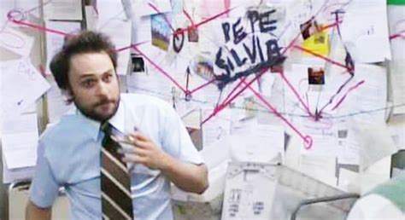
Complex crimes & criminality
Scale
Duration
Organisation
Multi-level
Power
Combining licit and illicit roles

Slide 7
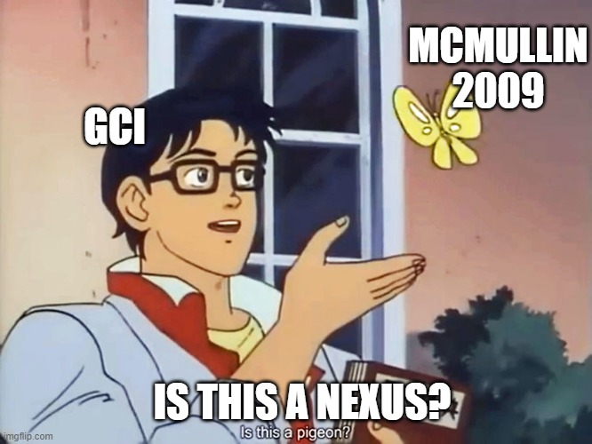
Interdependence: observations
Organised crime EXACERBATES conflict
Conflict generates OPPORTUNITIES for criminal groups
McMullin (2009)

Slide 8
Interdependence: challenges
Conceptual dichotomies
Criminal actors as adaptive
Conflicts shape criminalised economies
Tactical uses of violence

Slide 9
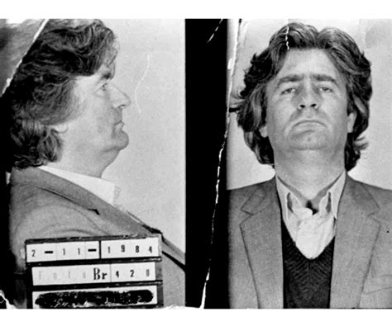
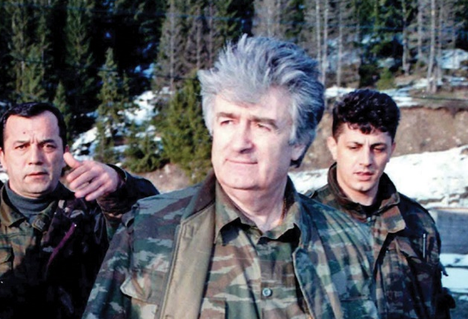
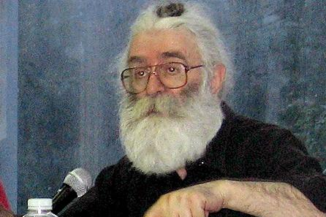
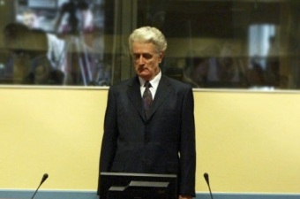
Criminal careers
Energoinvest fraud
Atrocity crimes
[quasi]state appropriation of public and private property
Customs fraud and support for PIFWCs

Slide 10
A meeting point?
Activity, illegality, justice and scholarship

Slide 11
Finding common ground
Forms of activity
Economic
Violent
Political
Taxation

Slide 12
Finding common ground
Associated illegalities
Economic
Violent
Political
Electoral intimidation

Slide 13
Finding common ground
Transition and justice
Economic
Violent
Political

Slide 14
Finding common ground
Economics Private Law
Criminological and other scholarship
Economic
Violent
Political
White Collar/ Corporate
Corruption
Org. Crime
Atrocity
State Crime
Aggression & Homicide
Pol Sci
IR
Psych
Public Law

Slide 15
The view from one shore
Criminologies of Atrocity and potential points of connection

Slide 16
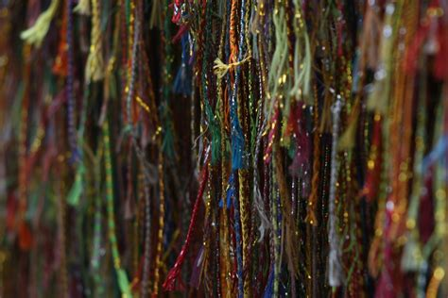
Criminological threads
Sociology of law
Etiology
Penology
Victimology

Slide 17
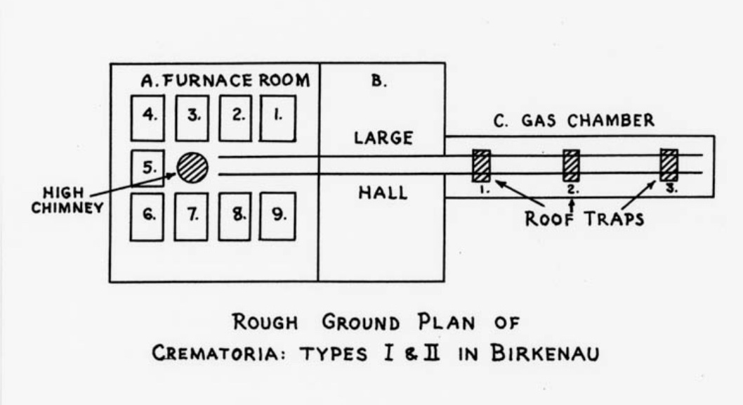
van Baar and Huisman
Topf und Söhne, crematoria/furnace manufacturers
Motivation, opportunity, control across 3 levels (sector, firm, individual)
Plan prepared by Rudolf Vrba and Alfred Wetzler

Slide 18
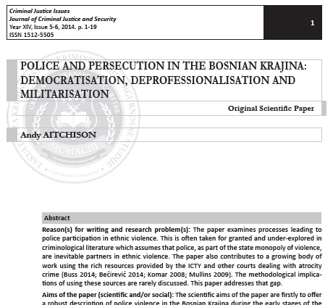
Police & Atrocity in B. Krajina
Democratisation
Ethnicisation
Deprofessionalisation
Militarisation
Economic dimension?

Slide 19
3 exemplars
Criminology, AKA Development Studies, Area Studies, Law

Slide 20
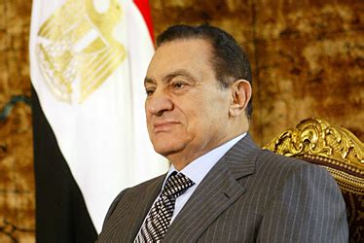
Marfleet on Egypt
Neo-liberal development, violence, fraud, corruption

Slide 21
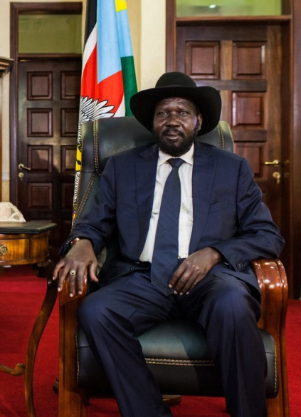
de Waal on South Sudan
Kleptocracy and ‘rent seeking rebellion’

Slide 22
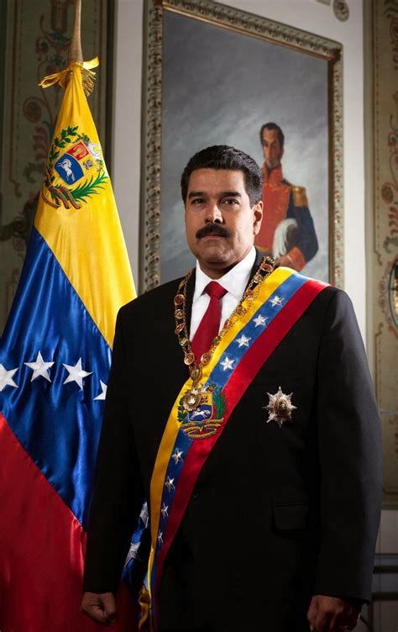
Roht-Arriaza & Martinez on Venezuela
Intertwining of corruption and crimes against humanity

Slide 23
Closing remarks
Before discussion

Slide 24
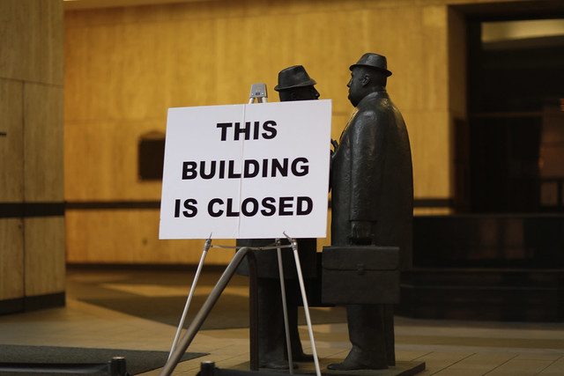
To close
Let’s talk
Questions of accountability and legitimacy
Prevention or prosecution
Depoliticising prosecution?

