Slide 1
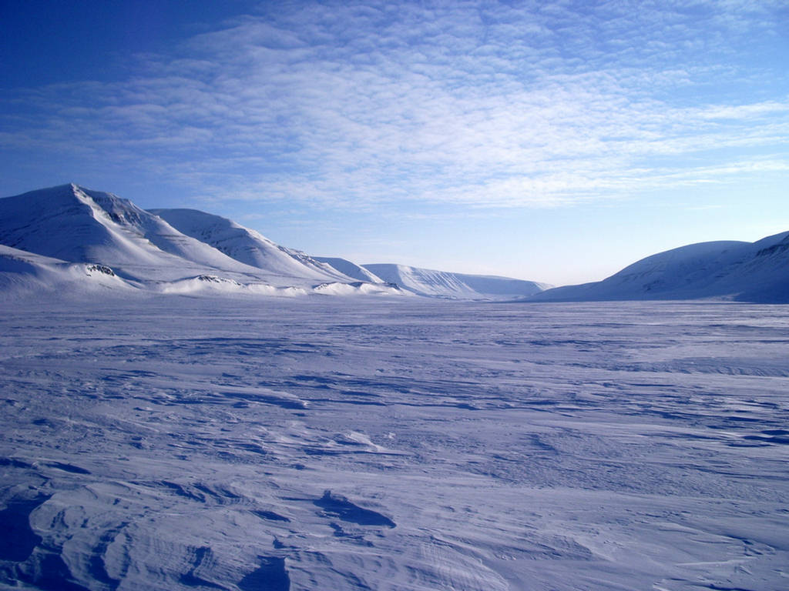
Antarctic sovereignty and its jurisdictional implications
Nikola Besek, mag.iur.
nikola.besek@gmail.com

Slide 2
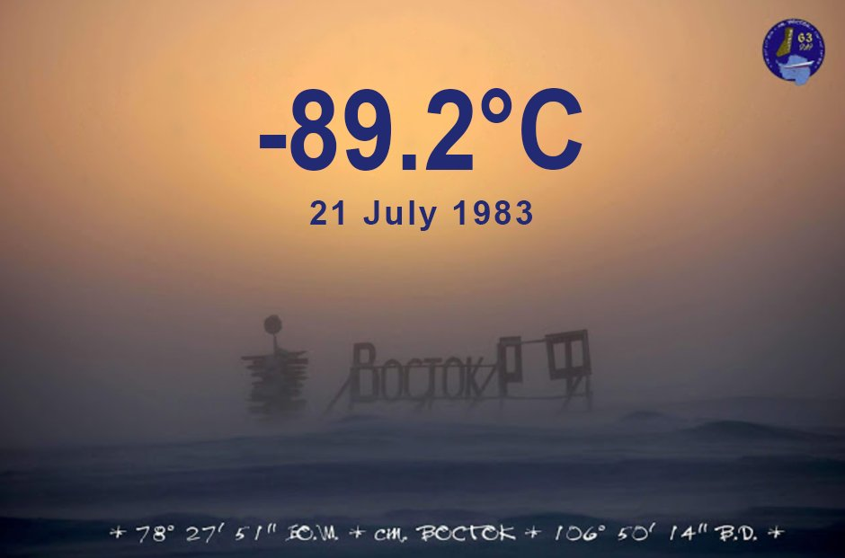
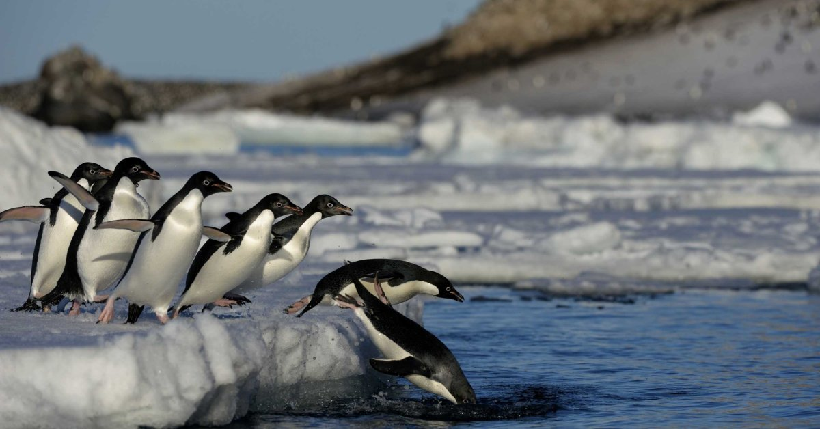
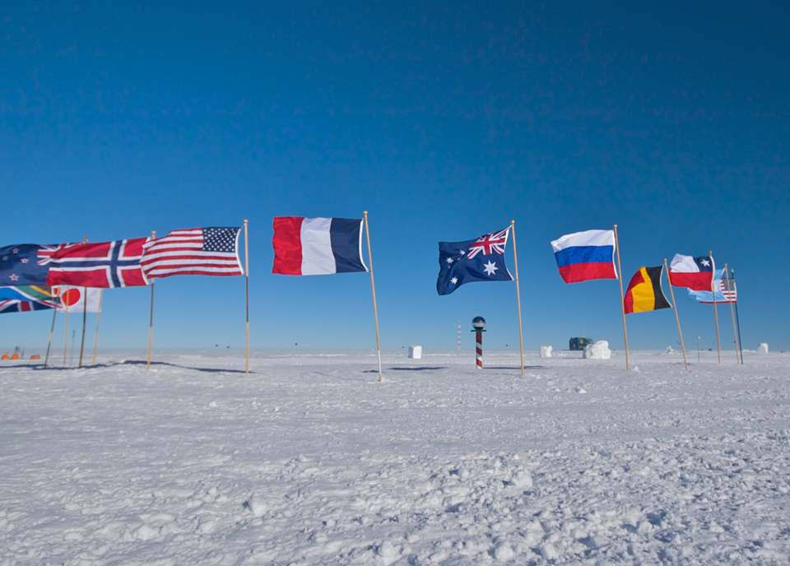
Lowest temperature recorded on Earth, Vostok station
Penguins on Paulet Island
South Pole

Slide 3
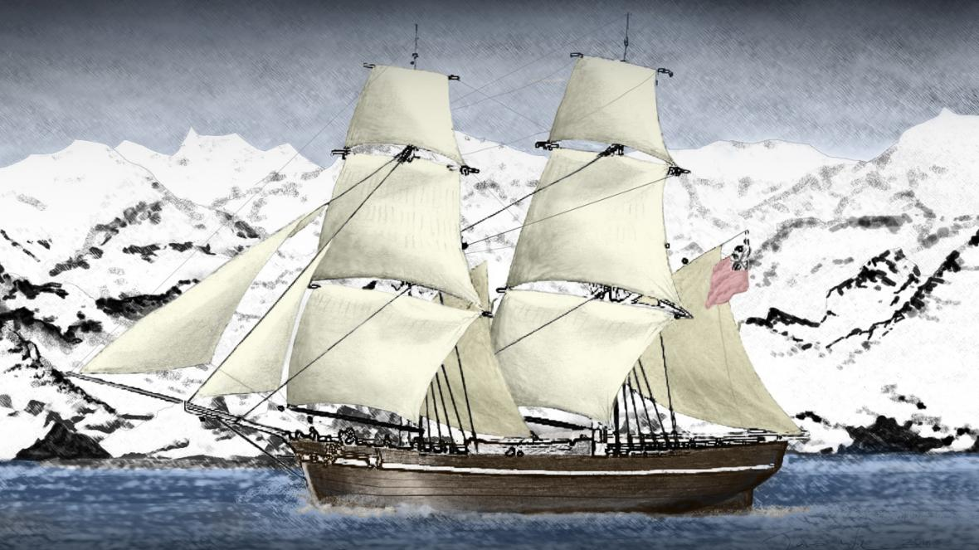
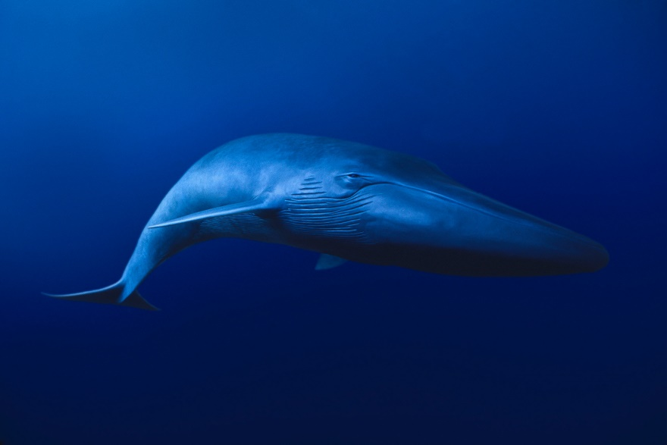
Human contact with Antarctic land in 19th century
Bransfield, 1820
whale and seal hunting
lots of natural resources, mineral not yet discovered
nudge to secure positions in case of mineral discovery and exploitation
Depiction of Bransfield’s journey
Blue whale

Slide 4
Territorial claims for sovereignty
from 1908 until the end of WWII
seven countries: UK, New Zealand, Australia, France, Norway, Argentina and Chile
bases: theory of discovery, uti possidetis principle, proximity
NONE of the claims satisfy requirements of occupation
  main method of acquiring terra nullius
  elements: length and effectiveness of occupation
international community does not recognize claims, even some claimant states do not approve each other’s

Slide 5
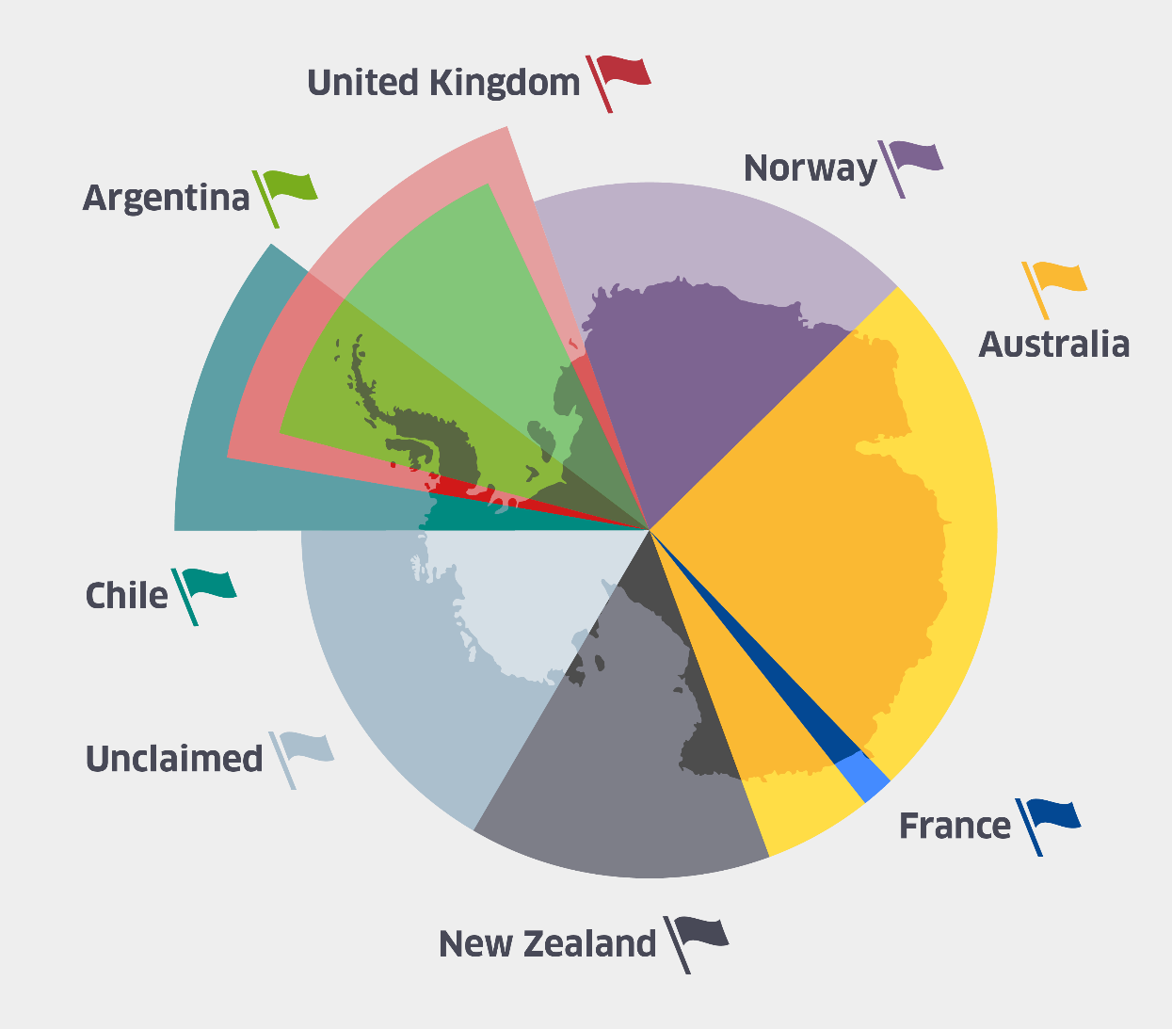
Territorial claims for sovereignty
≈85% of Antarctic land covered by claims
some of them overlapping (UK/ARG/CHI, AUS/FRA)
tension – UK actions against ARG and CHI at ICJ (dismissed, lack of jurisdiction)
USA stepped in, subsequently SSSR
International Geophysical Year 1957/58
  shift from politics to science
  boost for cooperation

Slide 6
Antarctic Treaty 1959
12 signatory states: claimant states, USA, SSSR, Japan, South Africa and Belgium (now 54, 29 consultative parties)
area of application: south of 60° South Latitude, incl. ice shelves, but not the high seas
principles of governance:
  use for peaceful purposes only (art. I)
  freedom of scientific investigation and cooperation (art. II)
  exchange of information, scientific personnel, observations and results (art. III)
  unanimous decision-making in Consultative Meetings (art. IX)
first international treaty to ban nuclear testing (art. V)
first continent to be demilitarized and be free of nuclear material

Slide 7
Article IV
solving the sovereignty issue? - „political anesthetic”
Art. IV. 1: „Nothing contained in the present Treaty shall be interpreted as:
  a) a renunciation of any Contracting Party (CP) of previously asserted rights of or claims to territorial sovereignty in Antarctica;”
  c) prejudicing the position of any CP as regards to its recognition or non-recognition of any other CP’s rights or claims or basis of claim
Art. IV. 2: No acts or activities taking place while the Treaty is in force shall constitute a basis for asserting, supporting or denying a claim. No new claim, or enlargement of an existing claim shall be asserted while the Treaty is in force.
≈ 85% of territory – „frozen” claims, but not internationally recognized
≈ 15% of territory – res nullius or res communis omnium

Slide 8
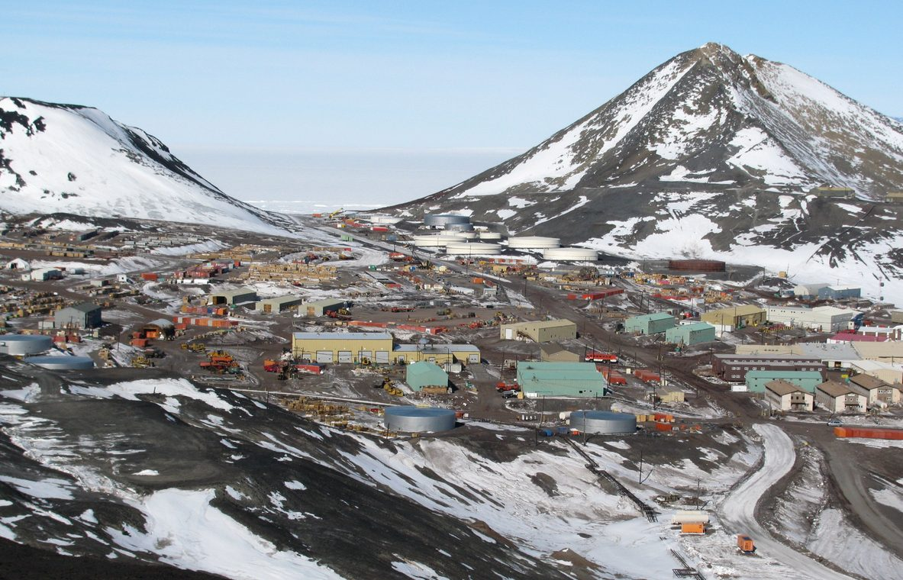
Jurisdiction in Antarctic region
based on nationality of scientific personnel and observers from the CPs (art. VIII. 1)
in case of dispute – immediate consultations (art. VIII. 2)
jurisdictional void – visitors, tourists, third-party nationals
in practice – territorial over ‘claimed sector’ but only on its own nationals, nationality-based, station-based (flag state jurisdiction analogy)
McMurdo station, largest Antarctic station

Slide 9
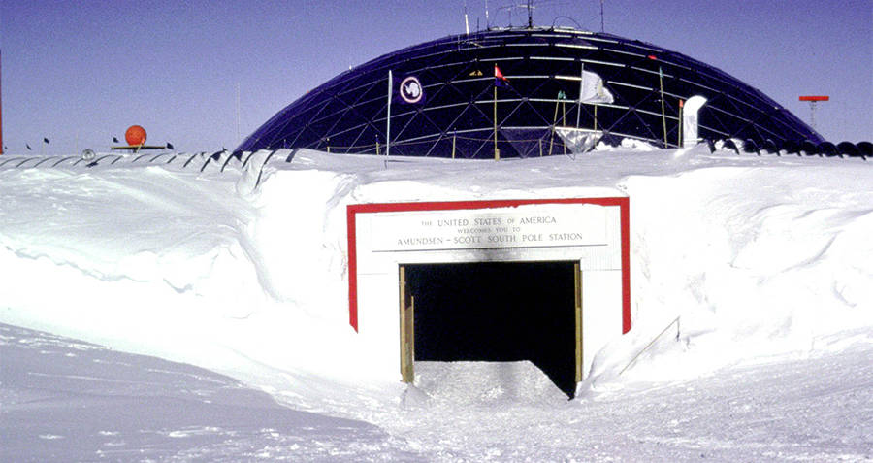
Jurisdiction in Antarctic region
exercising jurisdiction an important element of sovereignty
case study: a tourist of one CP committed a crime on a territory claimed by other CP (nationality-based vs. territorial)
case of Rodney Marks, 2000: Australian scientist, American station, New Zealand’s territory
Which criminal code is in force? (non-claimed territory, third-party national (e.g. tourist) on an internationally unrecognized territory)
Amundsen-Scott South Pole station

Slide 10
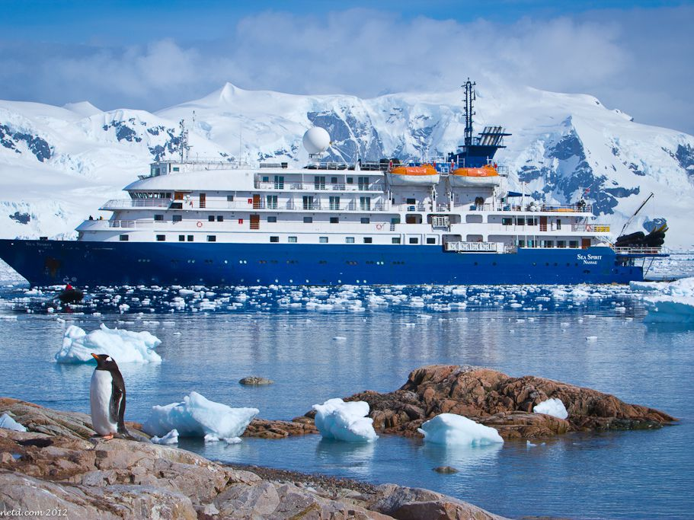
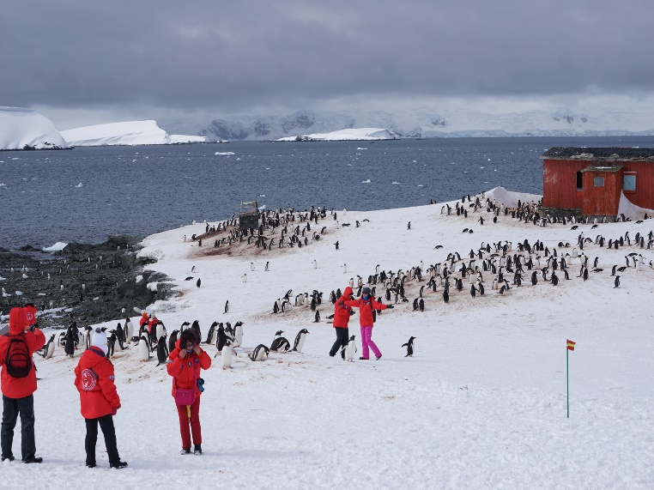
Tourism vs. environment
Protocol on Environmental Protection to the Antarctic Treaty, 1991 – first international treaty to regulate environmental protection outside national jurisdiction
tourists from non-member states not bound by the Protocol
≈40% of vessels from non-member states (not bound) – flag state jurisdiction + no sovereign state to protect territorial and internal waters
tourism not regulated – „supports” claims
2019/2020 season - ≈75 000 tourists (IAATO statistics)
Cruise-only visits
Landed visits

Slide 11
Conclusion
art. IV – great innovation in 1950s, now a hindrance to improvement
root of all problems – unresolved sovereignty issues (states clinging to possible exploitation of resources and profit in a fragile ecosystem)
unanimous decision-making (12 to 54 parties) blocks the regulation of tourism, enactment of a criminal code (solution: switch to a 2/3 majority without undemocratic distinction between parties)
utopian, but a common sense solution:
  radical shift in thinking - renunciation of territorial claims, understanding that de iure and de facto Antarctic belongs to no state but to the humankind as a whole, and most importantly to stop looking at the Antarctic environment (plants, wildlife, mineral resources, ecosystem) in terms of monetary value and resources and protecting it per se

